Slide 1
Vision, Goals, Schedule
Nombre de los proponentes

Slide 2
Project Basic Facts
Title: Start Date: 1/4/2017
Duration: 36 months
Budget: XXXXEuro

Slide 3
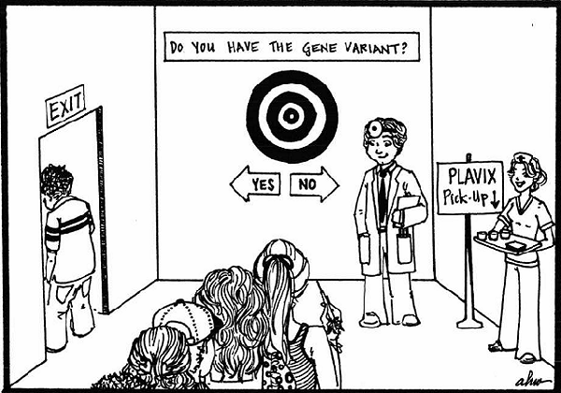
Motivation
Epidemiological data analysis is not sufficient for public health policies in the era of personalized/precision medicine.
We also need explanations, e.g. why a treatment ought to work better for one type of patient than another.
Therefore, we need to combine breadth (across a population) with depth (e.g. personal genome) in the analysis.
Big data analysis can address both breadth and depth, under the appropriate framework.

Slide 4
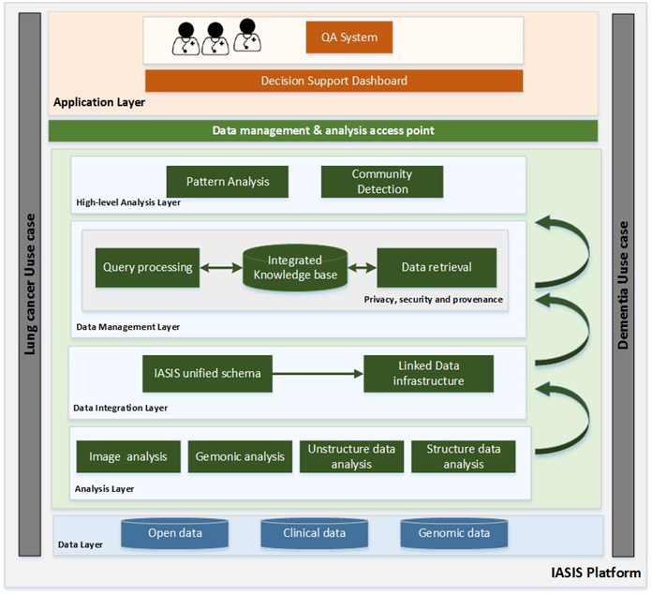
Vision and Objectives
This project ambition is to pave the way into a novel era of personalised diagnosis and treatment
XXXX will integrate automated unstructured and structured data analysis, image analysis and sequence analysis into a big data infrastructure.
XXXXXX will support more efficient and personalised diagnosis and treatment to the benefit of patients, clinicians, and healthcare providers.
XXXX will provide policy makers with access to the results of big data analysis through innovative question answering and visualization technologies.

Slide 5
Data Sources
Electronic Health Records (EHR) of individual patients.
Images related to the records.
Genomic data: genomic sequences of patients and other biological data, (e.g. RNA-binding proteins).
Related bibliography (e.g. MEDLINE).
Biomedical databases (e.g. DrugBank, PharmaGKB).
Biomedical ontologies (e.g. SNOMED, GO).

Slide 6
Scientific Goals
Understanding structured/unstructured clinical notes (EHR) in the right context.
Efficiently handling large volumes of medical imaging data and extracting potentially useful information and biomarkers.
Analysing genomic data and combining them with standard clinical data.
Extracting relevant knowledge from very large bibliographical and biomedical databases.
Exploiting knowledge encoded in biomedical ontologies to semantically describe clinical and genomic data.
Resolving data and fusion conflicts across the pieces of knowledge extracted in the above steps, in order to create the IASIS integrated knowledge base.
Drawing useful insights about the diseases and treatments.

Slide 7
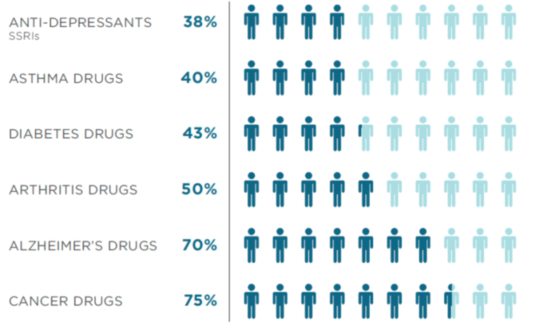
Motivation for pilots
Alzheimer’s and cancer in most need for personalized medicine.
Approx. 10% of people over 65 suffer from Alzheimer’s.
Lung cancer among the most common, most deadly and most costly cancers in Europe.
Big data from diverse sources available.
High impact for public health policies.

Slide 8
Pilot 1: XXXX
Investigate and determine a non-invasive method based on high-level analysis for uncovering patterns that will allow establishing:
more accurate correlations between
tumor spread,
prognosis and
response to treatment
unravelling molecular mechanisms that predict response depending on the type and characteristics of the tumor
Datasets:
Clinical data
Estimated volume for 1000 patients: 10 Mb
Genomic data
Total estimated volume: 7 Tb
Radiological (imaging) studies
Total estimated volume: 3 Tb
Pharmacological knowledge extracted from publicly available datasets
biomedical ontologies and taxonomies for
terminology standardization
semantically describing the EHRs

Slide 9
Ambition and Key Performance Indicators
Outcome | KPI
Mapping comprehensive big data in a reachable and manageable way by applying principles for sharing and reusability, creating a network of knowledge by linking heterogeneous data sources for public health strategy. | Large and shared data repository for lung cancer and dementia with data of at least 25,000 patients, from at least 5 different, heterogeneous sources.
Emerging data driven analytics and advanced simulation methods to study causal mechanisms and improve forecasts of spatial and temporal development of ill-health and disease. | Decisions about the diagnosis, treatment and prognosis of the disease (measured in the validation activities) will increase by 10% over conventional ways and/or if only one source of data was available.
Develop innovative approaches to improve current risk stratification methodologies. | Patient’s risk status (measured in the validation activities) will improve by 10% over conventional risk stratification methodologies
Turning large amounts of data into actionable information to authorities for planning public health activities and implementation of an approach “health in all policies”. | At least 5 more centres or health authorities will have committed to join and use the IASIS decision support platform to support multidisciplinary team decisions processes, by the end of the project.

Slide 10
Ambition and Key Performance Indicators
Outcome | KPI
Placing prevention strategies on evidence base, evaluation of the efficiency and effectiveness of implemented strategies, feedback of results into the development of methods. | At least 100 users (i.e. clinicians and health policy makers) from at least 5 research centres validate the system performance and accuracy; and at least 50 external from the project users validate the project results.
Analysing the efficiency of patient pathway management both at primary care level (prevention and early detection) and en route encompassing. | At least 100 users (clinicians and health policy makers) access the IASIS Web services four times per month in average. The number of detections of diseases in earlier stages can be increased in at least 10% over conventional ways; this will be measured in the validation activities.
Aligning big data and advanced simulation methods in order to provide high-leverage policy analysis for public health officials, across a range of epidemiology challenges. | If decisions about the definition of public health policies (measured in the validation activities) can be increased in at least 10% over conventional ways.
Cross-border and networking coordination and technology integration facilitates interoperability among the components of Big Data value chain. | A minimum of 10 dissimilar clinical and genomic data sets from at least two different countries are fully integrated with open pharmacogenomics data sources into the IASIS knowledge base. The IASIS platform receives at least 400 requests per month to execute the Web services deployed by the different layers of the IASIS architecture.

Slide 11
Partner Skills and Roles
Partner | Skills
 | Information extraction, Big data analysis, Data harvesting, Question Answering, Personalization
 | Custom service development and software integration, Marketing and promotional activities
 | Semantic Web, Linked Open Data analysis, Data harvesting, Biomedical data analysis
 | Data analysis, EHR analysis, Data harvesting
 | Big genomic data analysis
 | Linked data analysis
 | Lung cancer clinicians, EHR analysis, Data analysis
 | Dementia clinicians, EHR analysis, Data analysis
 | Alzheimer’s disease specialists, policy makers
 | Lung cancer specialists, policy makers, EHR analysis

Slide 12
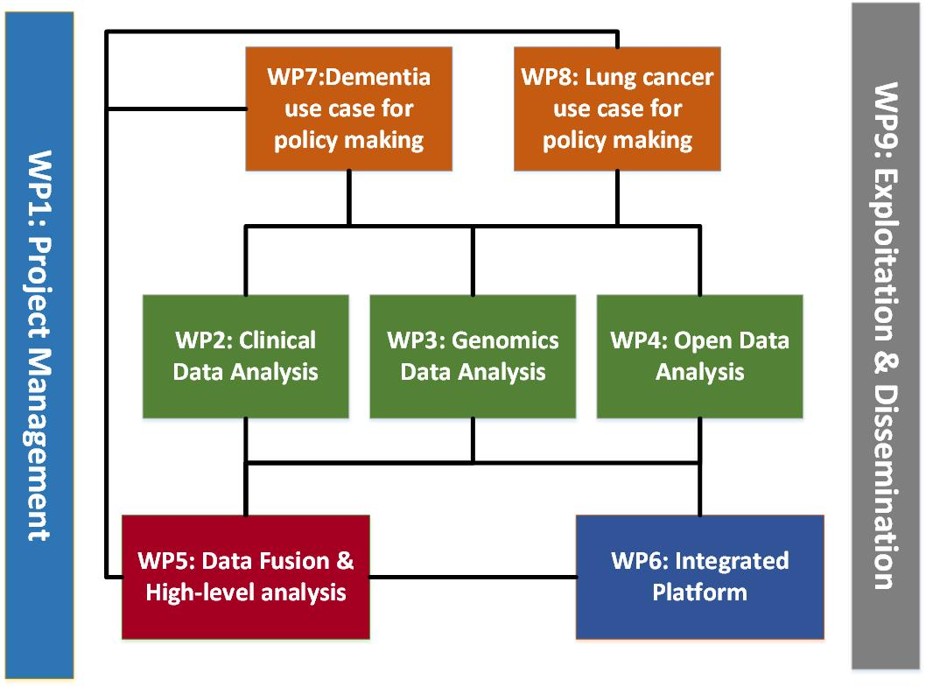
Workplan

Slide 13
Gantt chart

Slide 14
WP1 – Project Coordination
Tasks
T1.1 Project Control and Resource Monitoring
T1.2 Quality Management
T1.3 Risk Management and Contingency Planning
……
Goals
Support for the successful implementation of the project, through strong coordination and continuous monitoring and reporting

Slide 15
WPX –
Tasks
……
Goals

Slide 16
WP10 - Ethics requirements
Active Tasks
T10.1: Dementia Data management plan
T10.2: Dementia Privacy- and Trust-Aware Strategies
T10.3: Lung Cancer Data Management Plan
T10.4: Lung Cancer Privacy- and Trust-Aware Policies
Goals
Data management plan
Privacy- and trust-aware strategies
Ethics committee reports
Actions
Initial version of Dementia Data management plan
Initial version of Lung Cancer data management plan
Initial definition of the privacy- and trust-aware policies for Dementia and Lung Cancer
D10.1 - Dementia data management plan v1.0 (M6 – end of September)
D10.5 - Lung cancer data management plan v1.0 (M6 – end of September)

